Slide 1
Onboard new hires to contributing team members FAST!
Keith Wedinger
Software Engineer

Slide 2
Agenda
Introduction
Meet Root Insurance
How not to onboard…
The Root Way…
Links
Questions

Slide 3

Before we get started…
No need to write down or take pics of slide deck content
Presentation: https://goo.gl/D223VE

Slide 4
Introduction
28+ year career
Several development projects for multiple companies
IBM, Lexmark, Diebold, Limited Brands, Sterling Commerce, IBM (again), Leading EDJE, Crown Equipment Corp, Wendy’s, OEC, Improving, Ohio State, Abercrombie & Fitch, Root Insurance
Enjoy dining, traveling and craft brewery exploration with my wife
Who are you?

Slide 5
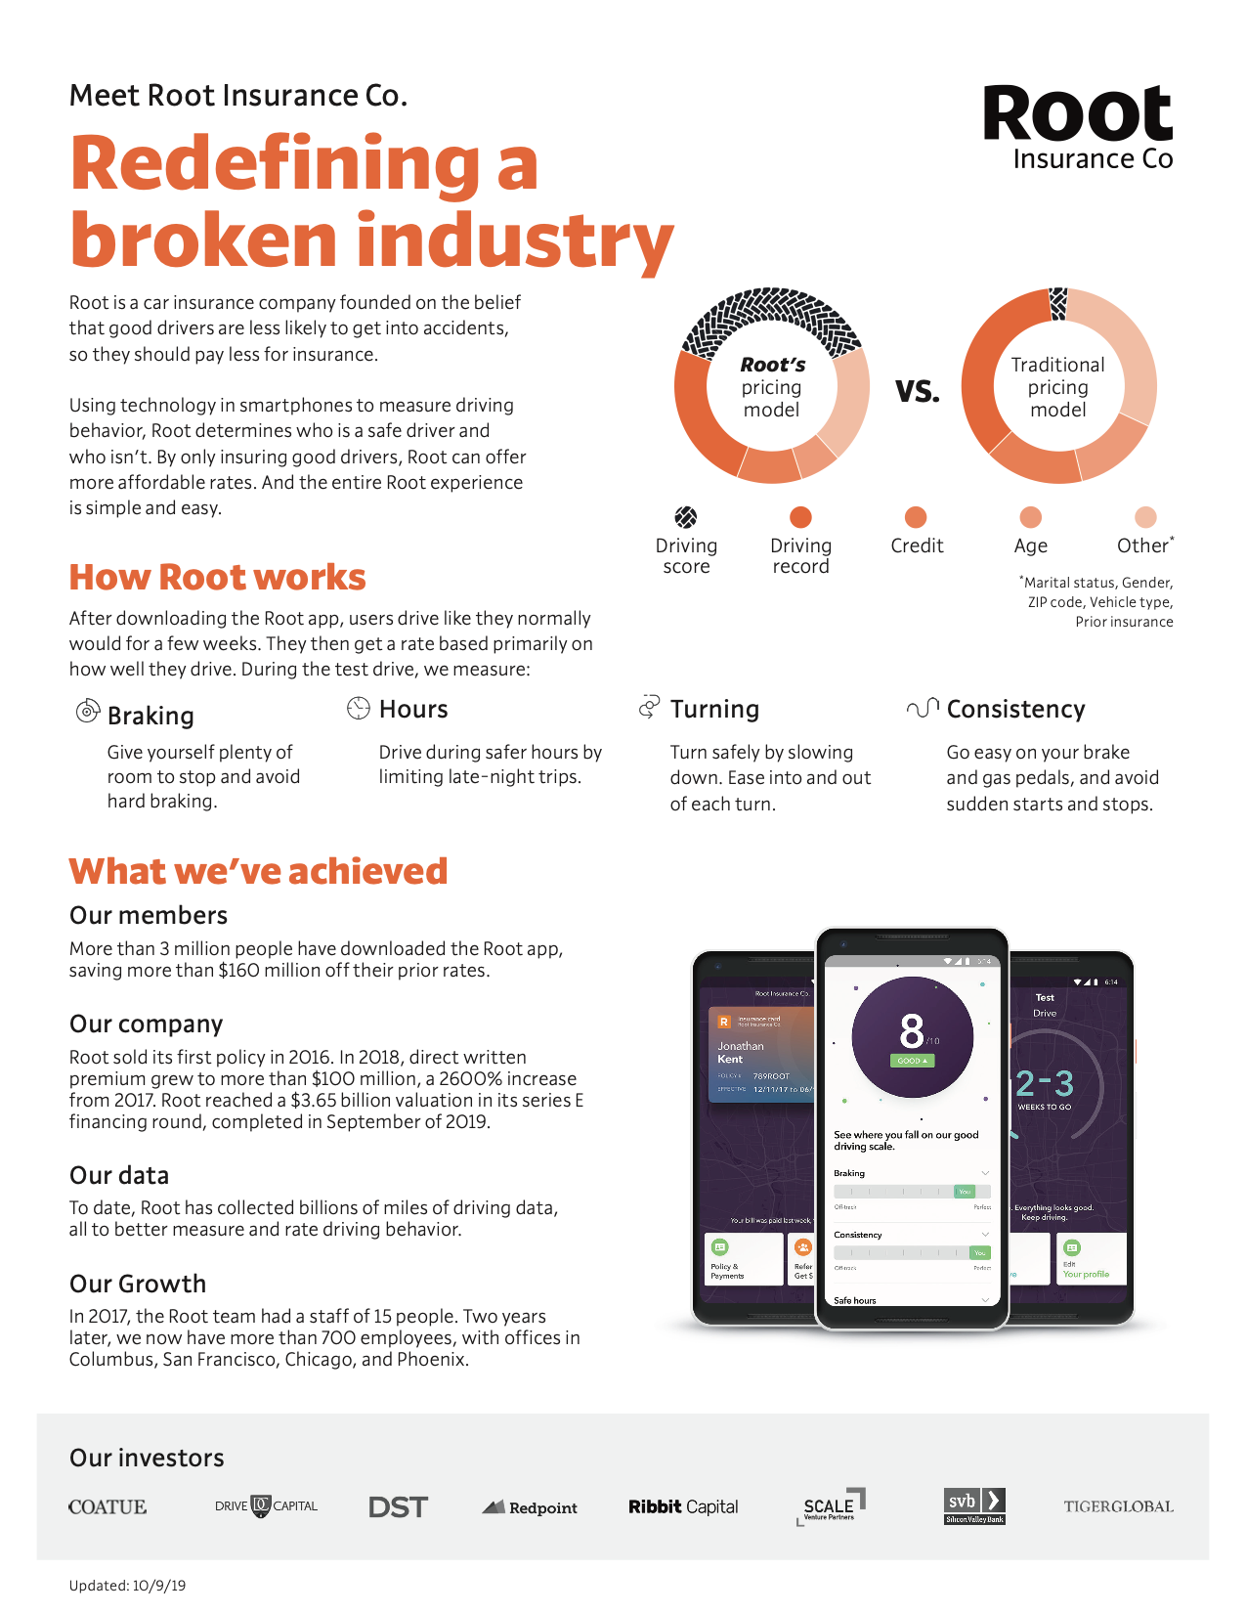

Slide 6
How not to onboard…

Slide 7
The Root Way…
Onboarding Trello board for manager and new engineer
Uniform hardware and dev box setup
Pair programming with experienced engineer to deliver first feature

Slide 8
Links
https://www.joinroot.com
https://root.engineering
https://www.ansible.com
https://trello.com

Slide 9
Questions
keith.wedinger@icloud.com
Twitter: @jkwuc89
Blog: https://jkwuc89.github.io
LinkedIn: https://www.linkedin.com/in/kwedinger
GitHub: https://github.com/jkwuc89
Untapped (for craft beer folks 🍺): jkwuc89
THANK YOU FOR ATTENDING!

